Slide 1

CS-3002 Information Security
Introduction
Rabia Ahmed Ansari
Lecturer: Computer Science
E: rabia.ansari@nu.edu.pk
2026-Fall-Week 1-3

Slide 2


Week 1 Outline
Evaluation and LMS tools
Grading Policy and Books
Computer Security Concepts
Threats, Attacks, and Assets
Security Functional Requirements
Fundamental Security Design Principles
Attack Surfaces and Attack Trees
Computer Security Strategy
Standards
Key Terms, Review Questions, and Problems

Slide 3
Learning Objectives
Describe the key security requirements of confidentiality, integrity, and availability.
Discuss the types of security threats and attacks that must be dealt with and give examples of the types of threats and attacks that apply to different categories of computer and network assets.
Summarize the functional requirements for computer security.
Explain the fundamental security design principles.
Discuss the use of attack surfaces and attack trees.
Understand the principal aspects of a comprehensive security strategy.

Slide 4

Evaluation and LMS tools
FLEX:
  Attendance record
  Evaluation record
Google Classroom:
  Course material and books
  Assignments
  Project submissions
  Any other communication

Slide 5
Grading Policy
Item | Weightage
Mid | 15+15
Final | 50
Project | 10
Quizzes (2 Quizzes) | 5
Assignments (2 Assignment) | 5

Slide 6
Important Notes
No re-quiz will be entertained
Late submission and plagiarism policy will strictly be followed
Make notes during the lecture it will be considered as a class participation

Slide 7

Class Policies

Slide 8
Course Project
A project focusing on:
  Computer security related problem
  Project topics are limited to IT Security Management and Risk Assessment Problems and their solutions including use of any tools covered in this course.
  Proposals based on programming are not entertained.
  Marks distribution: 20% proposal, 60% Documentation and Execution, 20% Presentation

Slide 9
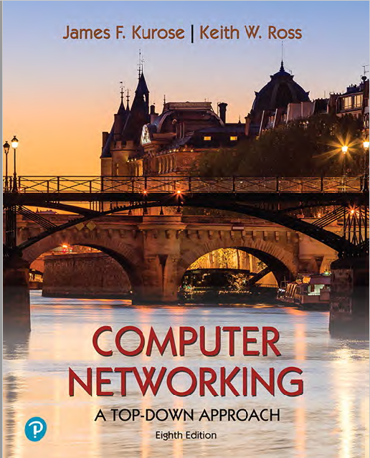
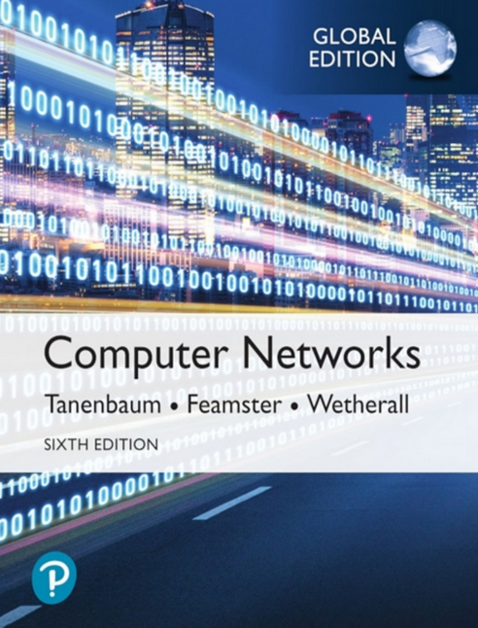
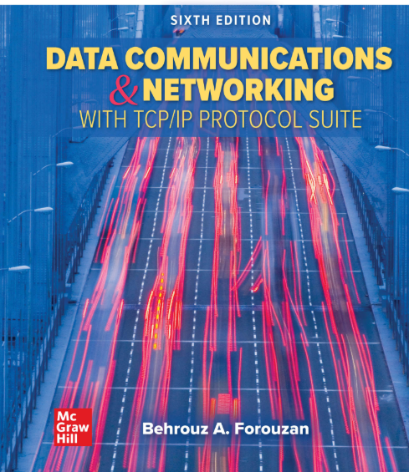
Textbooks:
  James F. F. Kurose and Keith W. Ross, "Computer Networking: A Top-Down Approach," 8th Ed. 2021
  Data Communications and Networking with TCPIP Protocol Suite, 6th Edition (Behrouz A. Forouzan) (Z-Library)
  Andrew S. Tanenbaum, Nick Feamster, David J. Wetherall - Computer Networks-Pearson (2021).

Slide 10

Course Objectives:
Explain key concepts of information security such as design principles, cryptography, risk management.
Discuss legal, ethical, and professional issues in information security.
Analyze real-world scenarios, model them using security measures, and apply various security and risk management tools for achieving information security and privacy.
Identify appropriate techniques to tackle and solve problems of real life in the discipline of information security.
Understand issues related to ethics in the field of information security.

Slide 11


Notes:
NIST-National Institute of Standards and Technology

Slide 12
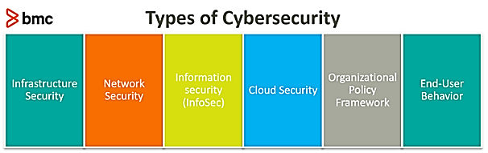
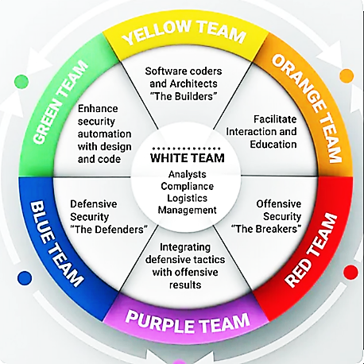
Information security
Infrastructure Hardware (CPU + Box)
Application Security
OS security
Network Security (Router, Switches, + Boxes)

Slide 13
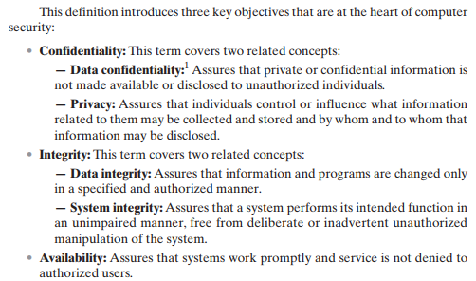

Slide 14
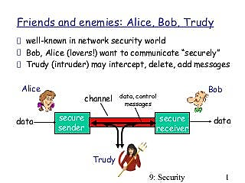

Slide 15
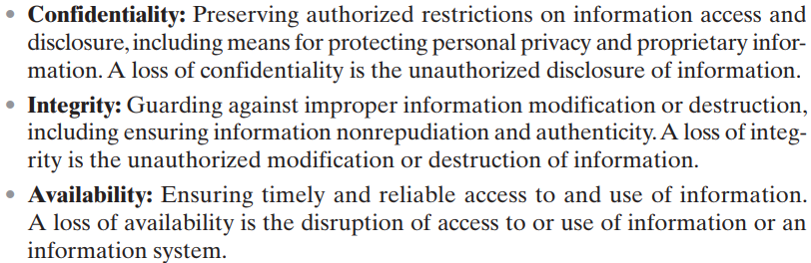
CIA Triad

Slide 16
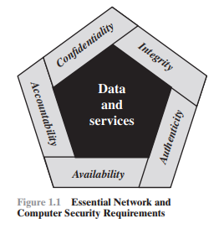
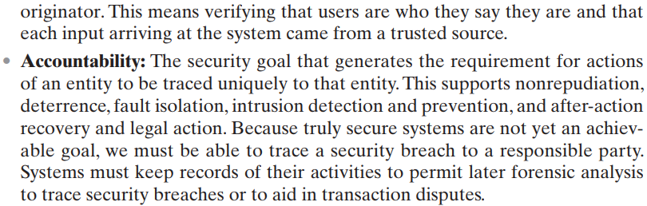
Two additional concepts are needed to present a complete picture
Low
Moderate
High
FIPS (Federal Information Processing Standards)

Slide 17
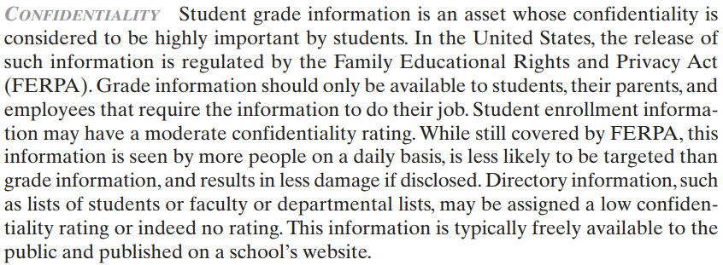
Real World Examples: Confidentiality, Integrity and Availability
Impact of Risk:
Low
Moderate
High

Slide 18
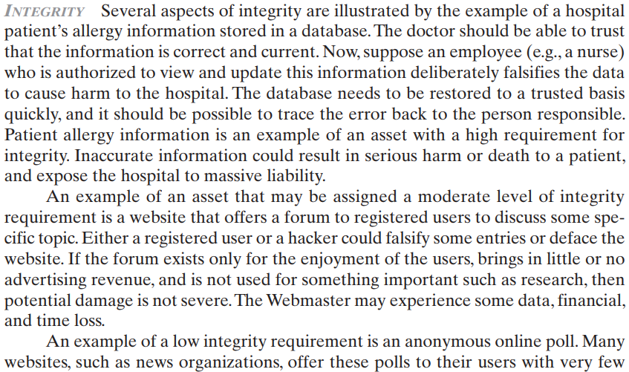
Real World Examples: Confidentiality, Integrity and Availability

Slide 19
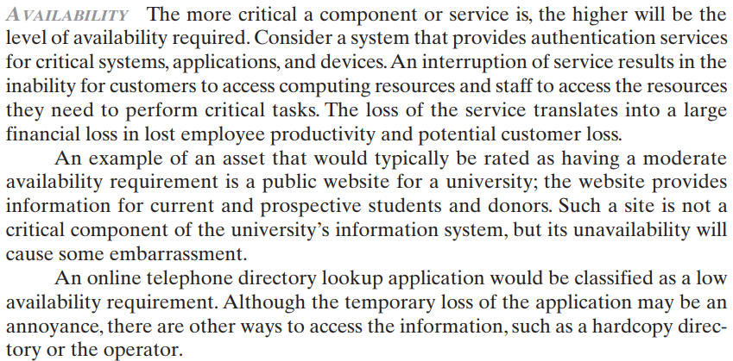
Real World Examples: Confidentiality, Integrity and Availability

Slide 20
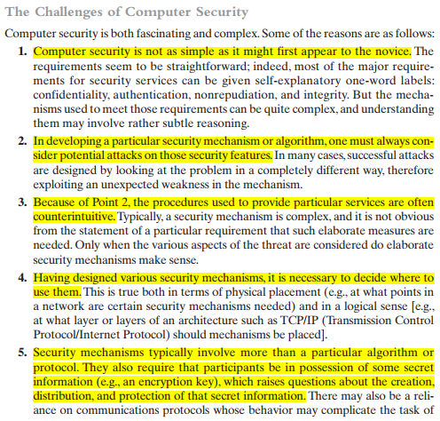
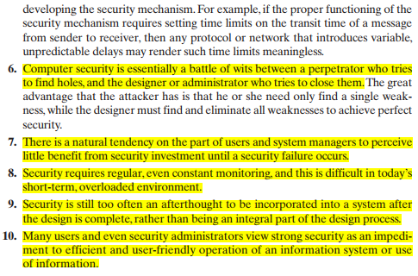
The Challenges of Computer Security

Slide 21
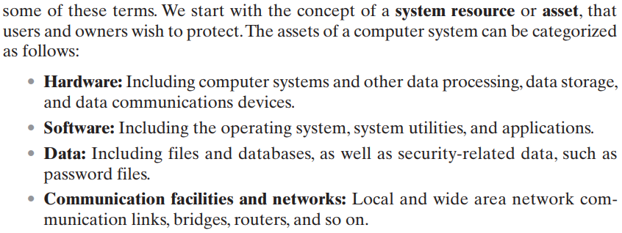
A Model for Computer Security

Slide 22
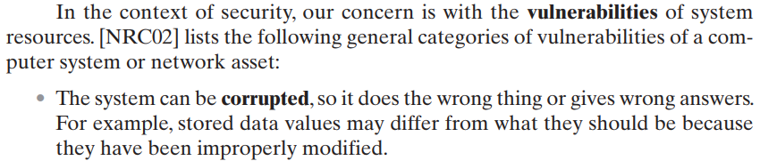
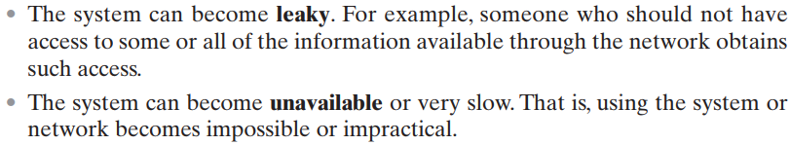
A Model for Computer Security
These three types of vulnerability correspond to the concepts of integrity, confidentiality, and availability

Slide 23
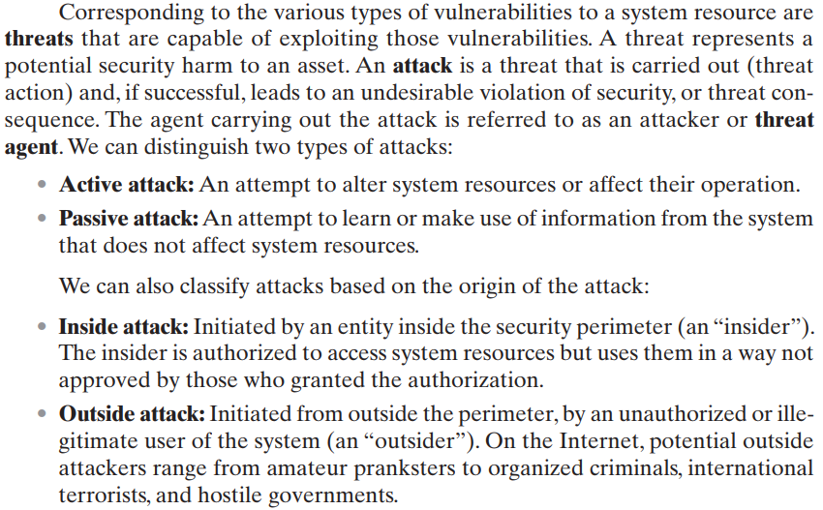
A Model for Computer Security
Active Attack: harm for Integrity as well as Availability.
e.g: DoS attack
Passive Attack: harm for Confidentiality.
E.g Sniffing

Slide 24
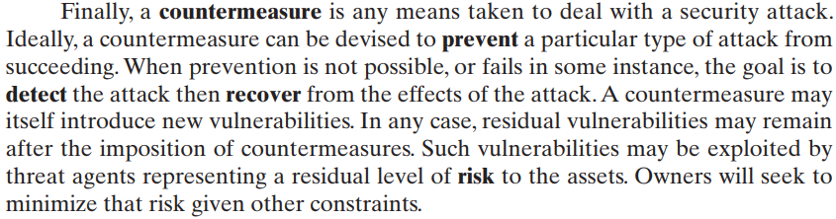
A Model for Computer Security

Slide 25
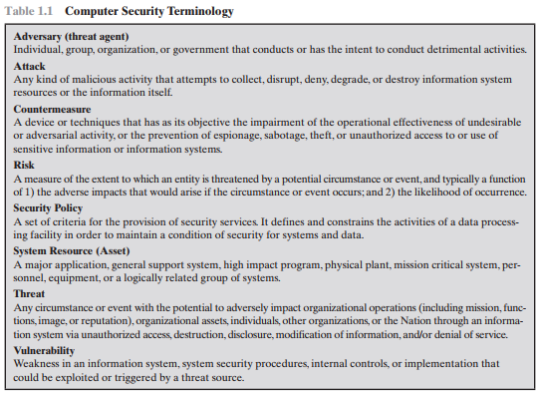

Slide 26
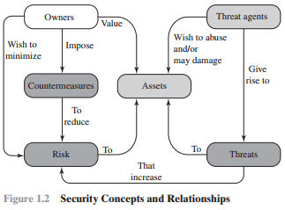

Slide 27
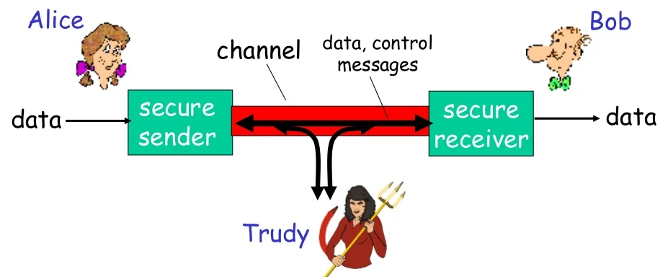

Slide 28
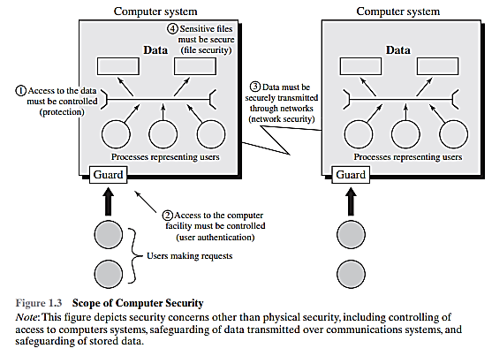


[1] Access to the data must be controlled (protection)
[2] Access to the computer facility must be controlled (user authentication)
[3] Data must be securely transmitted through networks (network security)
[4] Sensitive files must be secure (file security)
Physical Security
OS Security
Application
Social Engineering

Slide 29
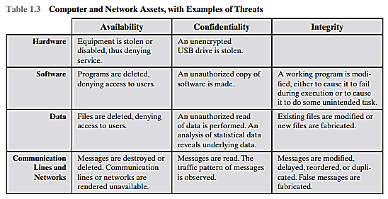

Slide 30
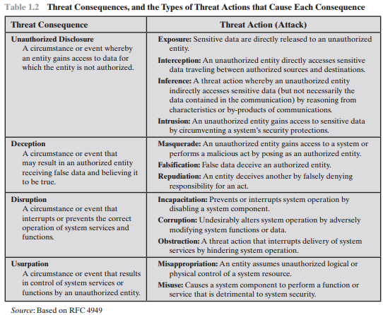

Slide 31
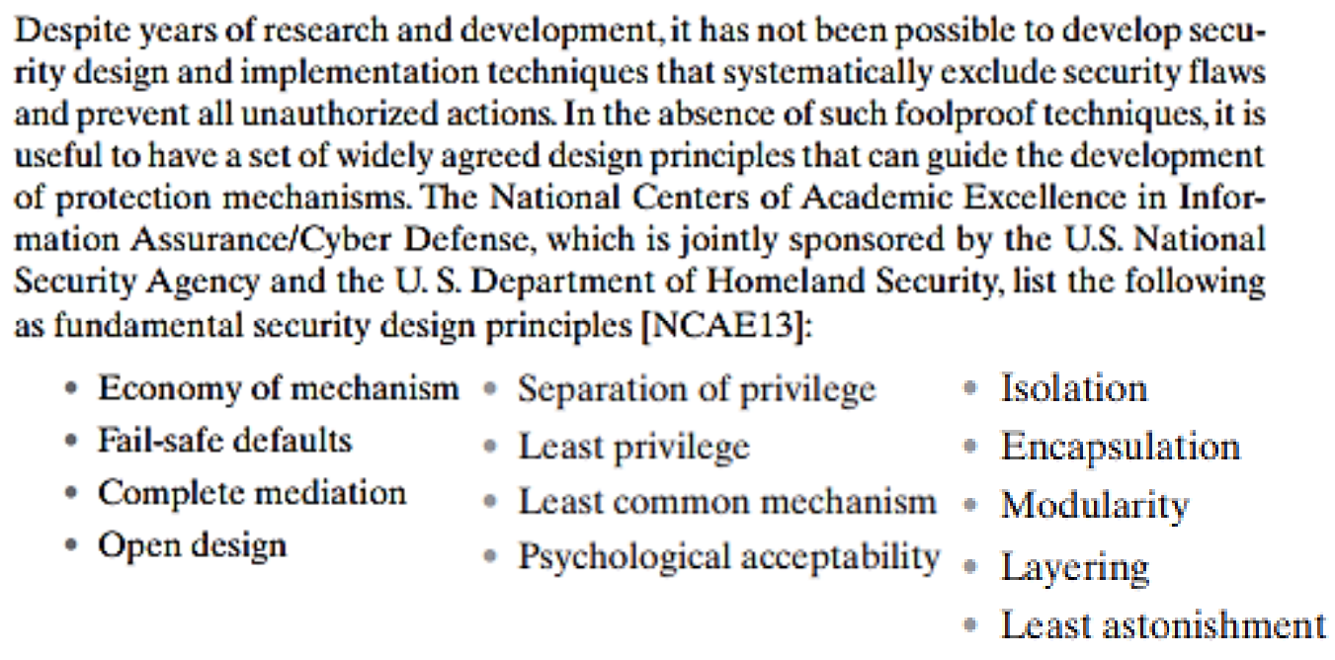
Fundamental Security Design Principles

Slide 32
Fundamental Security Design Principles
Economy of mechanism: Keep security mechanisms as simple and straightforward as possible. This reduces the potential for errors and vulnerabilities that can arise from complex designs.
Fail-safe default: The default action should be to deny access or secure access.
  For example: If the firewall fails, let no traffic in
Complete mediation: Ensure that every access to a resource is checked for authorization (usually check once).
  For example: if you change the password it asks for an authentication
Open design: This means the design of a security mechanism should be open rather than secret.
  For example: Although encryption keys must be secret, encryption algorithms should be open to public investigation
Separation of privilege: Multiple privilege attributes are required to achieve access to a restricted resource. (Access should not granted based on a single attribute)
  For example: The use of multiple techniques, such as a password and a smart card, to authorize a user (Multifactor authentication)
Least privilege: Grant users and processes only the minimum permissions necessary to perform their tasks.
  For example: Role Based Access Control (RBAC) Model
Least common mechanism: Sharing components or resources among different users or processes should be minimum. possible. This reduces the potential for one user's actions affecting another user’s security.
  For example In stack, if a user is sharing the file in user module, it should be in the user module

Slide 33
Fundamental Security Design Principles
Psychological acceptability: Security measures should be designed in a way that it introduce a minimum hurdles to the user of the system.
  For example: if person come to the campus it has to go through with the eye scan instead of access card
Isolation: the system that has a critical data, process or resources must be isolated such that it restrict public access
  For example: Multiple users in the same operating system, each user will manage its own account (isolated from each other) OR also example of VM
Encapsulation: is a specific form of isolation based on object oriented functionality.
  For example: if you are designing a password module the algorithm and methods of password will create in a class.
Modularity: The security mechanism must of generated as separate and protected modules and using the modular architecture.
  For example: if an update is required then a specific module will update
Layering: refers to the use of multiple, overlapping protection approaches addressing the people, technology, and operational aspects of information systems
  For example: Multiple barrier for the attacker if try to access the information (type of user, identification, firewall)
Least astonishment: The user interface of the system must not amaze the user while accessing the secure system

Slide 34
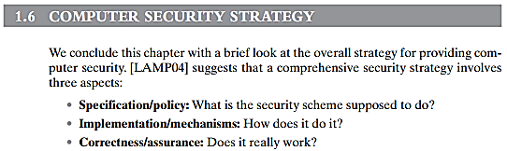
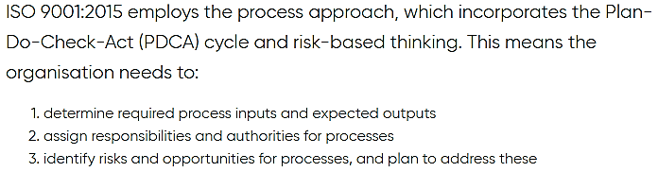

Slide 35
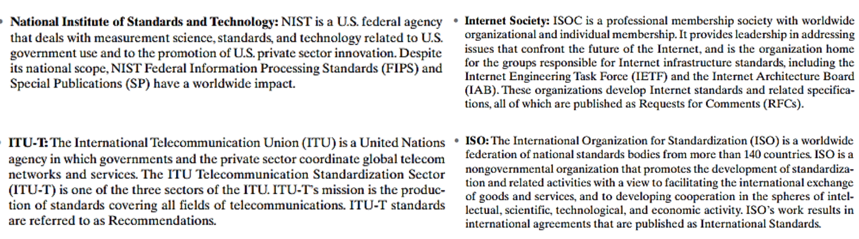
Standards

Slide 36
Computer Security Strategy
Security Policy:- Formal statement of rules and practices that specify or regulate how a system or organization provides security services to protect sensitive and critical system resources
Security Implementation:- Involves four complementary courses of action:
    Prevention
    Detection
    Response
    Recovery
Assurance:- Encompassing both system design and system implementation, assurance is an attribute of an information system that provides grounds for having confidence that the system operates such that the system’s security policy is enforced
Evaluation:- Evaluation Process of examining a computer product or system with respect to certain criteria Involves testing and may also involve formal analytic or mathematical techniques

Slide 37
InfoSec Practice
Identification of Assets
Identify Vulnerabilities
  (CIA + Authentication + Auditable)
Risk Assessment → Possible Threats
Known and possible Attacks
Test and Implement known Countermeasures
  Based on community Best Practices
Governmental and Community based efforts
  Groups (Meetups) + CERTs + Conferences + Certifications

Slide 38
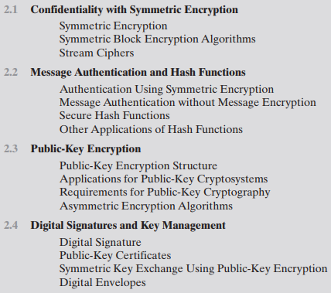
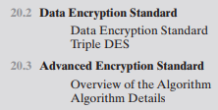

Possible Coverage before Midterm # 1
Topics from Chapter # 2, Chapter # 20 and Chapter # 21

Slide 39



Slide 40

Encryption is the process of converting information or data into a code, especially to prevent unauthorized access.

Slide 41
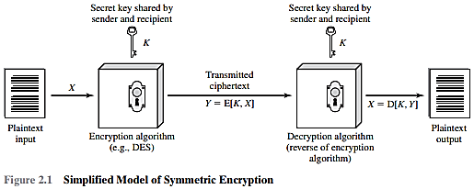

Slide 42
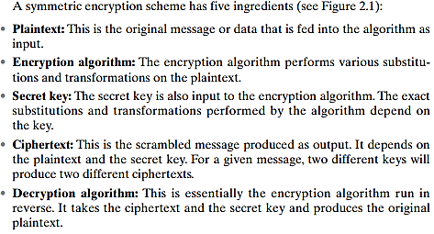

Slide 43
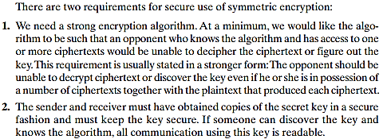

Slide 44
Attacking a Symmetric Encryption Scheme (1)
Brute-force attack is to try every possible key on a piece of cipher text until an intelligible translation into plaintext is obtained.
  On average, half of all possible keys must be tried to achieve success. That is, if there are x different keys, on average an attacker would discover the actual key after x/2 tries.
  This means size of key has a great impact of breaking the symmetric Encryption schedule. Larger the key the more time it will takes to try all possible key combinations.
More information about plain text is needed to break in less time (i.e. trying half the keys):
  Language of the plain text. This make it easy to recognize the result.
  If the text message has been compressed before encryption, then recognition is more difficult.
  A numerical file that has been compressed, the problem becomes even more difficult.

Slide 45
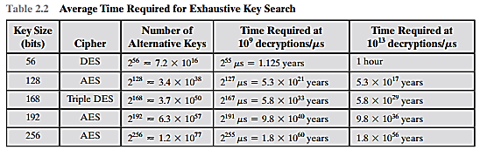
Attacking a Symmetric Encryption Scheme (1)
There are two general approaches to attacking a symmetric encryption scheme.
Brute-force attack is to try every possible key on a piece of cipher text until an intelligible translation into plaintext is obtained.
  On average, half of all possible keys must be tried to achieve success. That is, if there are x different keys, on average an attacker would discover the actual key after x/2 tries.
  This means size of key has a great impact of breaking the symmetric Encryption schedule. Larger the key the more time it will takes to try all possible key combinations.

Slide 46
Attacking a Symmetric Encryption Scheme (2)
Cryptanalysis. Cryptanalysis refers to the process of analyzing information systems in order to understand hidden aspects of the systems.
Cryptanalysis is used to breach cryptographic security systems and gain access to the contents of encrypted messages, even if the cryptographic key is unknown.
This attacks rely on the nature of the algorithm plus perhaps some knowledge of the general characteristics of
  the plaintext, or
  some knowledge of some plaintext-ciphertext pairs.
This type of attack exploits the characteristics of the algorithm to attempt to deduce a specific plaintext or to deduce the key being used.
  If the attack succeeds in deducing the key, the effect is catastrophic: All future and past messages encrypted with that key are compromised.

Slide 47
Symmetric Block Encryption Algorithms
Types of Symmetric Encryption
  Block Ciphers
  Stream Ciphers
Symmetric Block Encryption Algorithms
  DES and AES
  Weaknesses of DES and Triple-DES
Data Encryption Standard (DES) Algorithms

Slide 48
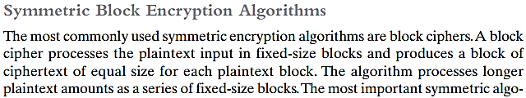


Slide 49
Application of Block and stream cipher
For applications that deal with blocks of data, such as:
  File transfer
  E-mail
  Database
  File and disk encryption
For applications that require encryption/decryption of a stream of data, such as over a data communications channel or a browser/Web link, a stream cipher might be the better alternative.

Slide 50
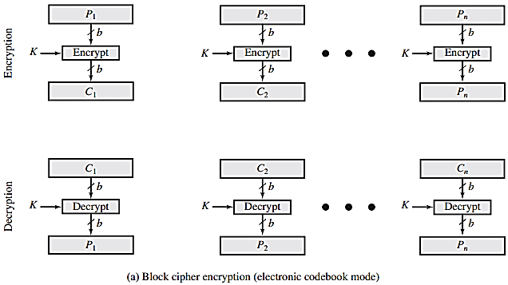

Slide 51
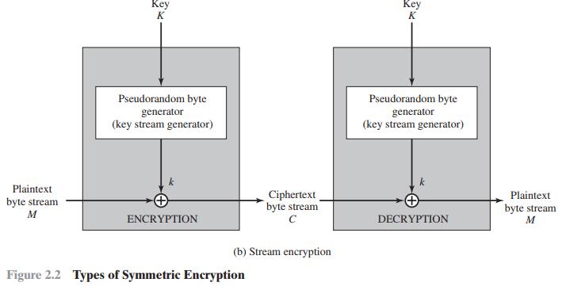

Slide 52

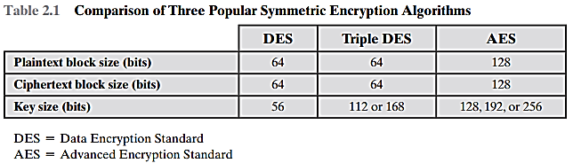

Slide 53
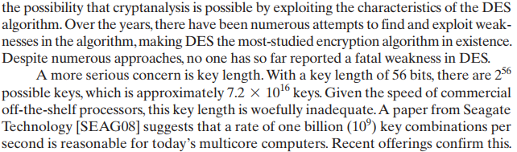

Concerns about the strength of DES Algorithm (1)

Slide 54
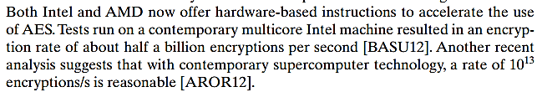
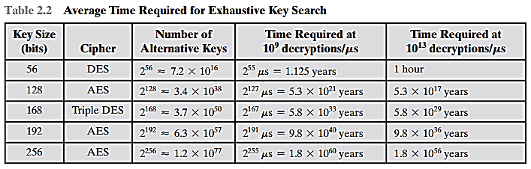
Concerns about the strength of DES Algorithm (2)

Slide 55

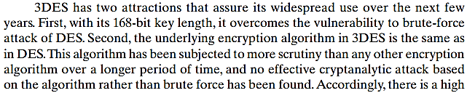

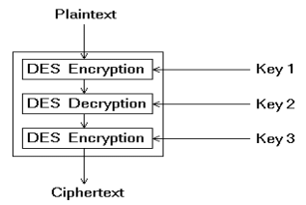
Addressing the small key size of DES Algorithm

Slide 56
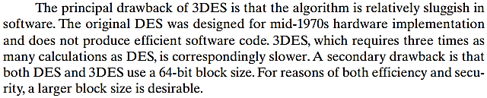
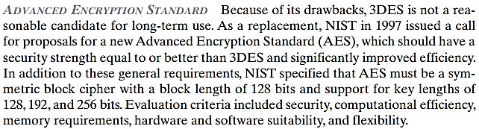
Drawback of DES Algorithm

Slide 57

Coverage from slides provided by Course Coordinator

Slide 58
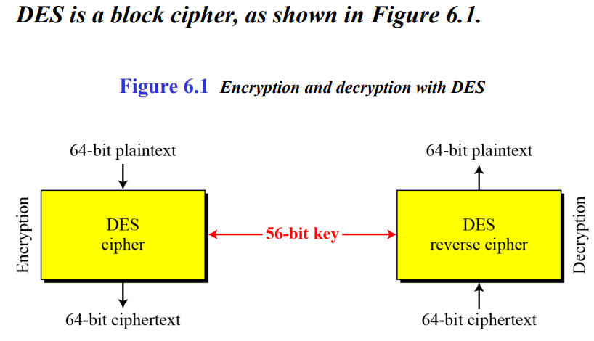
Notes:
DES is called a 56-bit cipher because only 56 of the 64 key bits participate in encryption; the remaining 8 bits are parity bits. 2^56 combinations are possible so todays hardware can brute force des relatively quickly.

Slide 59
Data Encryption Standard (DES)
The DES algorithm can be described as follows.
  The plaintext is 64 bits in length
  The key is 56 bits in length
  There are 16 rounds of processing.
  From the original 56-bit key, 16subkeys are generated (ki= 48 bit)
    one of which is used for each round.
Encryption process:
  Permutation performed on the input block
  Generation of round keys
  Performing 16 identical rounds
    Substitution
    Permutation
  Inverse permutation to step 1

Slide 60
Data Encryption Standard (DES)
Decryption process:
  Use the ciphertext as input to the DES algorithm, but use the sub-keys Ki in reverse order.
  That is, use K16 on the first iteration, K15 on the second iteration, and so on until K1 is used on the sixteenth and last iteration.

Slide 61
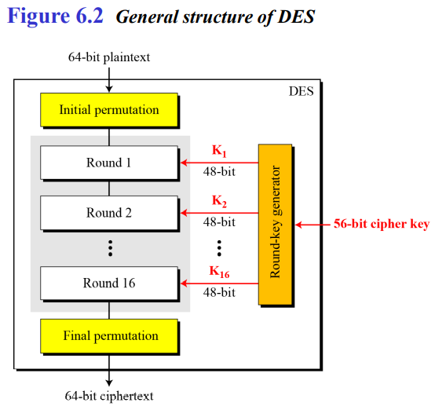
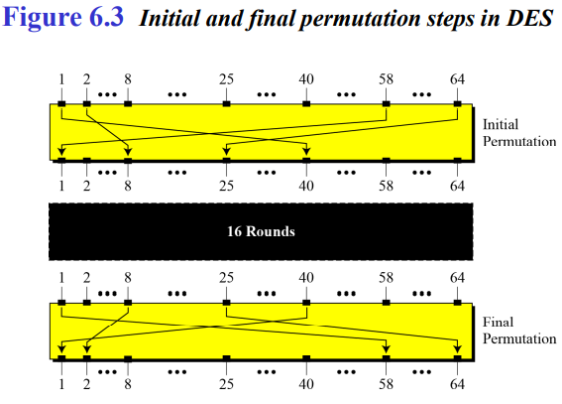

Rule: In the initial permutation, the 58th bit in the input becomes the first bit in the output. Similarly, in the final permutation, the first bit in the input becomes the 58th bit in the output.
The initial and final permutations are straight P-boxes that are inverses of each other. They have no cryptography significance in DES. Both permutations are keyless and predetermined.

Slide 62

Original Plaintext 64 bits
After Permutation Plaintext 64 bits Positions

Slide 63


Slide 64




Textbook page 631-631

Slide 65

Textbook page 631-631

Slide 66





By duplicating bits
Details on next slide
Details on next slide

Slide 67


Expansion P-box
Since R_{I−1} is a 32-bit input and K_{I} is a 48-bit key, we first need to expand R_{I−1} to 48 bits.
Figure 6.6 Expansion permutation
Note: The number of output ports is 48, but the value range is only 1 to 32. Some of the inputs go to more than one output.

Slide 68



(Substitution Boxes)
* There are 8 S-Boxes. Each one has its own table.

Slide 69


Each 8-S-boxes has a 6-bit input and a 4-bit output.
The values of the inputs (row number and column number)
Each 6-bit piece uses as an address in the S-boxes where the first and last bits are used to address the i^{th} row and the middle four bits to address the j^{th} column in the S-boxes.
The output of each S-box is 4-bit length piece. The output of all eight S-boxes is then combined into 32 bit section
* Each S-box has its own table.

Slide 70


Slide 71

Example: S1(101010)
1st and 6th bit = Row
Middle bits = Colum
So: 06 =0110 is the original data.

Slide 72






Slide 73
Steps:-
It drops the parity bits (bits 8, 16, 24, 32, 40,48,56, & 64) from the 64-bit key and permutes the rest of the bits according to Table 6.12
From this 56-bit key, a different 48-bit Sub Key is generated during each round using a process called key transformation
For this, the 56-bit key is divided into two halves, each of 28 bits.
These halves are circularly shifted left by one or two positions, depending on the round.
For example, if the round numbers 1, 2, 9, or 16 the shift is done by only one position for other rounds, the circular shift is done by two positions.

Slide 74
Thank you

